Slide 1
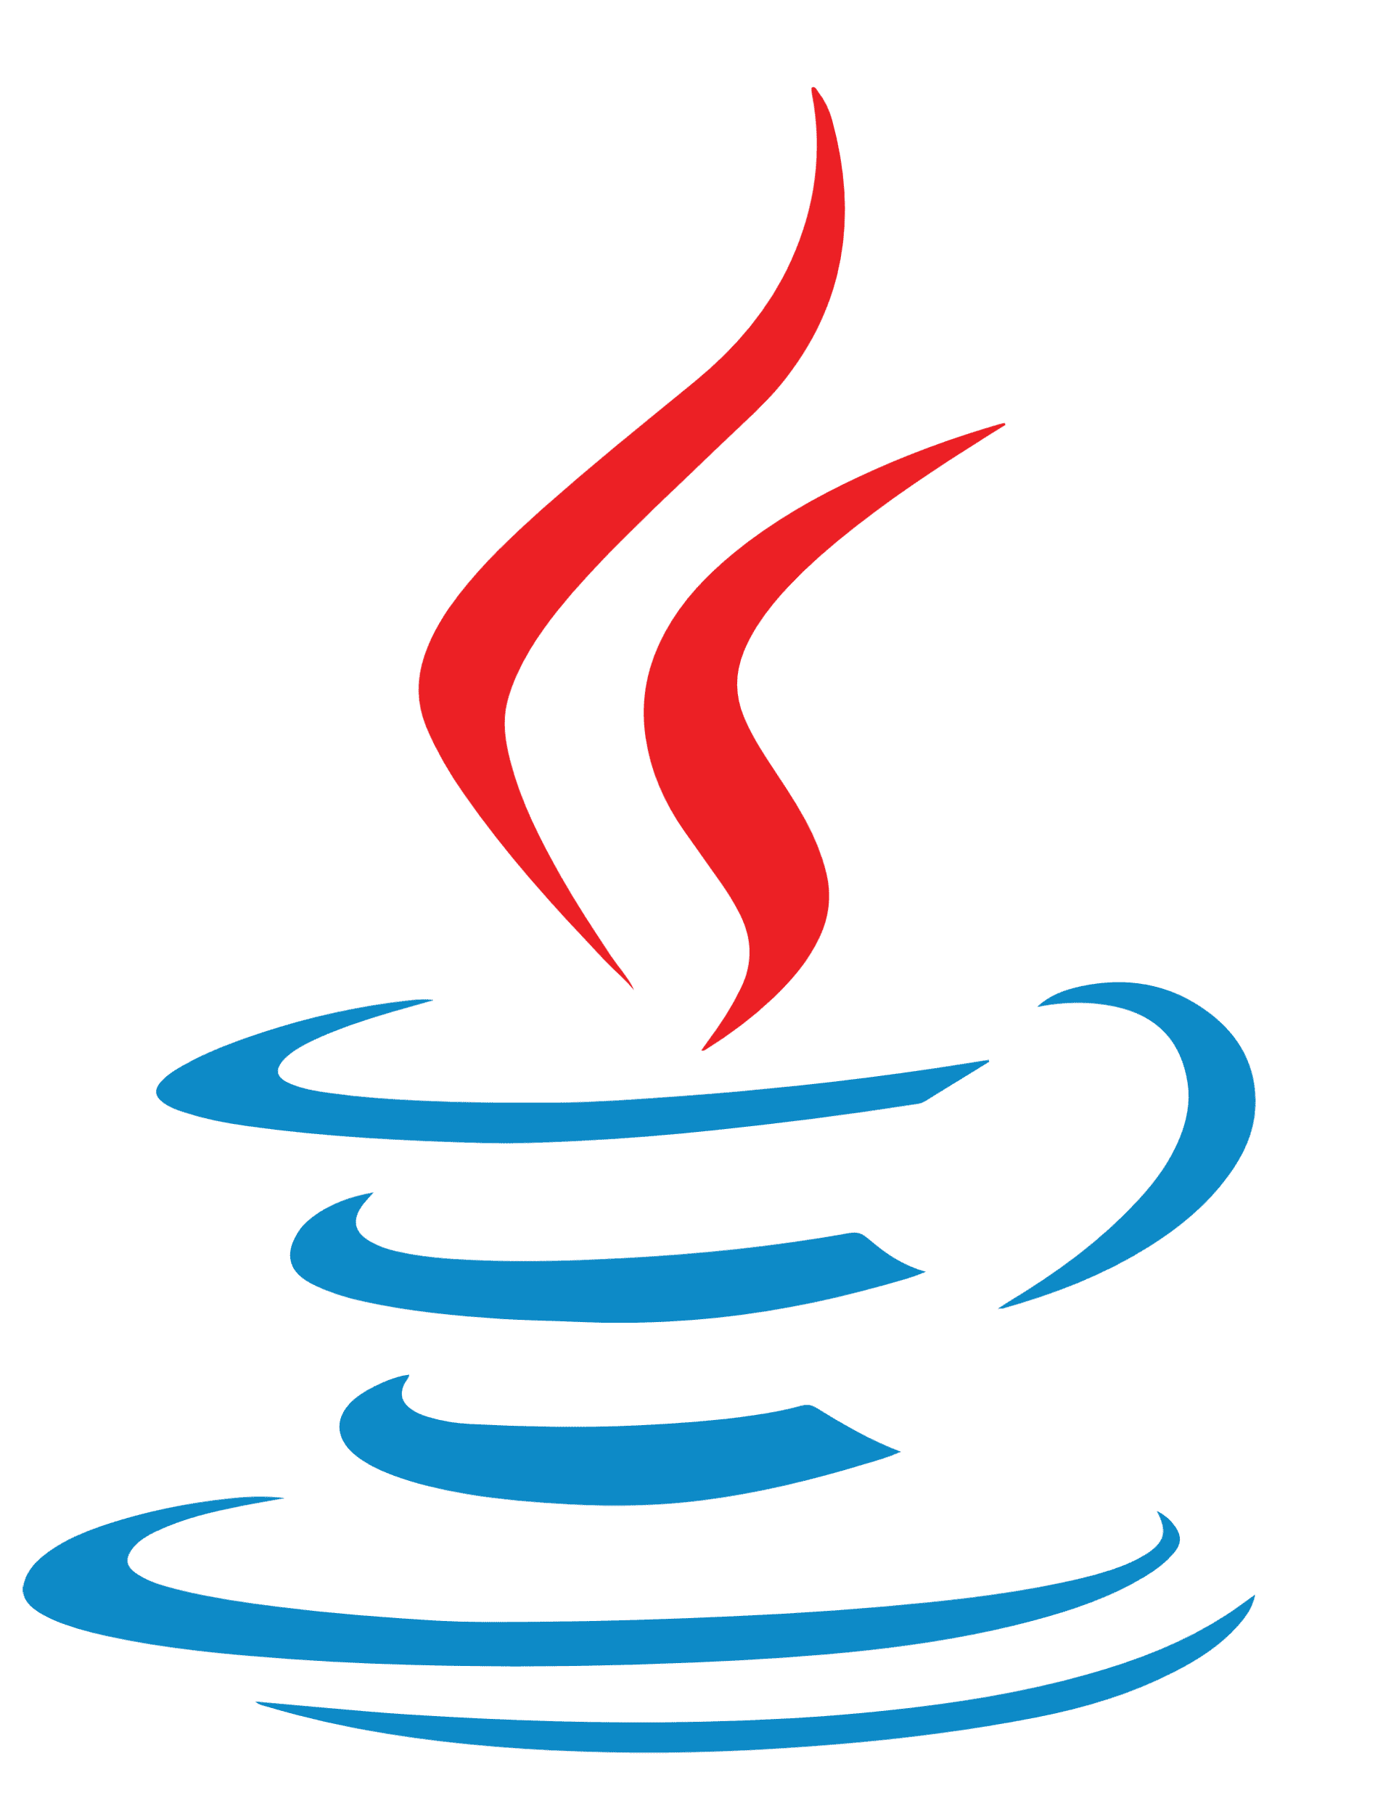
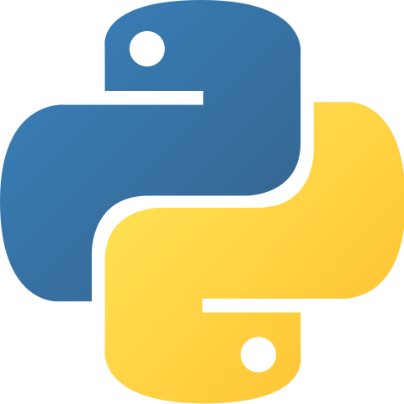
Java vs. Python
19102077 Kang Seok-Jun
21102052 Lee Jeong-Yun

Slide 2
Which one is Better, Java or Python?
Features
Application

Slide 3
Java
https://1000logos.net/java-logo/

Slide 4
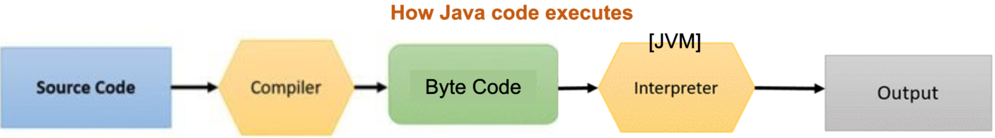
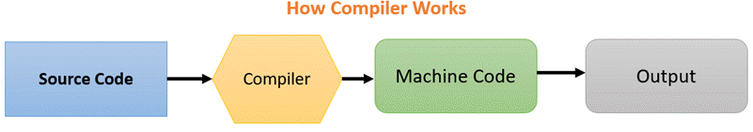
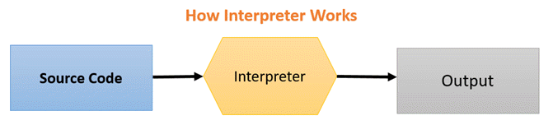
Features
JVM(Java Virtual Machine): Compiler + Interpreter
→ Fast run + Cross-platform

Slide 5

Features
• Static type & Hard syntax
→ reduce errors

Slide 6
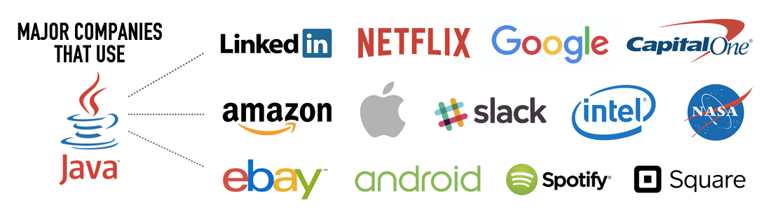

Application
designed for networking in mind
→ Web Application (Business App)
https://www.codemotion.com/magazine/backend-dev/reasons-to-learn-java/

Slide 7
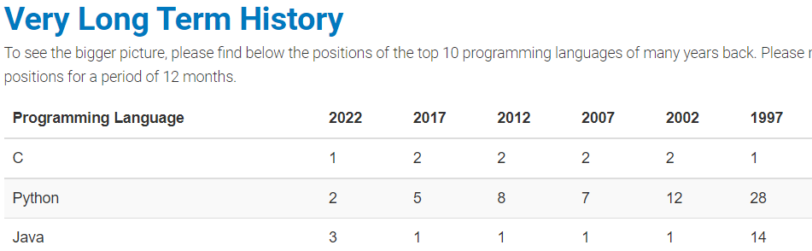

Application
released in 1995
→ community support, still high usage (TIOBE Index for March 2022)
https://www.tiobe.com/tiobe-index/

Slide 8
Python
https://ko.wikipedia.org/wiki/%ED%8C%8C%EC%9D%BC:Python-logo-notext.svg

Slide 9
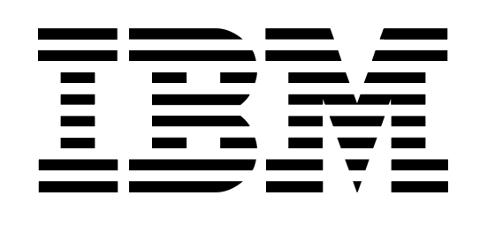
Features
Python: Interpreted Language → Cross-platform
https://www.ibm.com/docs/en/zos-basic-skills?topic=zos-compiled-versus-interpreted-languages

Slide 10
Features
Dynamic Programming Language
→ Flexible, Fast Coding

Slide 11
Features
Simple and Intuitive Codes
Java
Python

Slide 12

Application: Machine Learning
Libraries and Frameworks
Simplicity
Fast Code Test
https://www.section.io/engineering-education/why-python-is-good-for-machine-learning/

Slide 13
Conclusion
Java | Language | Python
Compiler (+Interpreter) | How to Run Code? | Interpreter
Performance | Productivity | Development Speed
More | Amount of Codes | Less
More Stable | Stability | Less Stable
Hard to learn | Difficulty | Easy to learn
Web Application | Application | Machine learning

Slide 14
Java vs. Python
Thank you
19102077 Kang Seok-Jun
21102052 Lee Jeong-Yun
Do you have any questions?

